Slide 1

Personal Fitness &
Workout Tracker
Track workouts. Hit goals. Know your BMI.
PRESENTED BY
• Syed Irfan (2620030054)
• Abhiram (2620040122)
FACULTY GUIDE : Gopi Krishna
PERSONAL FITNESS / JAVA PROJECT

Slide 2
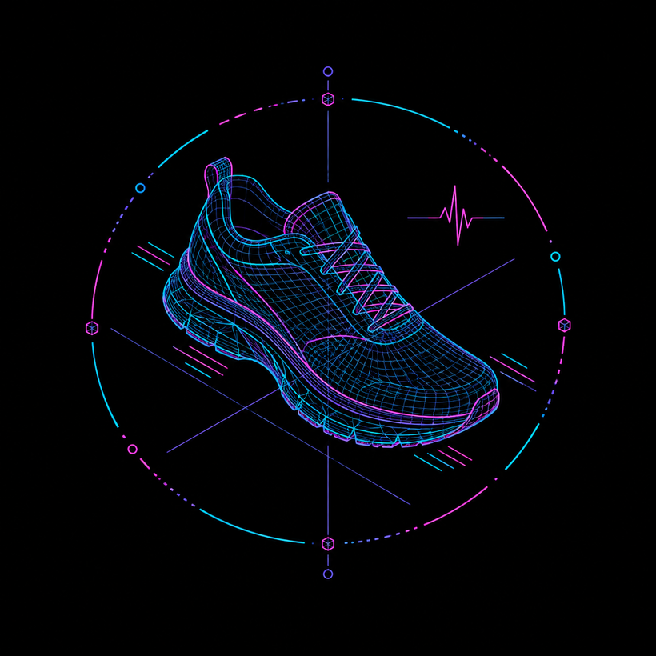
INTRODUCTION
Your daily fitness data,
one simple console.
A Java console app that logs multiple workouts, totals calories automatically, checks daily goal progress, and calculates BMI with a health category.
FAST INPUT • INSTANT FEEDBACK • CORE JAVA
PERSONAL FITNESS / JAVA PROJECT

Slide 3
The problem is fragmented.
THE PROBLEM
THE PROBLEM
Current issues
User challenges
Paper tracking is messy
Calories are added by hand
People forget goal progress
BMI needs a separate calculator
PERSONAL FITNESS / JAVA PROJECT

Slide 4
Five clear objectives.
01
02
03
04
05
Set a daily
calorie goal
Log multiple
workouts
Total calories
automatically
Check goal
achievement
Calculate BMI
and category
PERSONAL FITNESS / JAVA PROJECT

Slide 5
Today’s method leaves gaps.
CURRENT STATE
THE GAP
How it works today
Where it falls short
Notebooks and memory
Separate BMI websites
Manual math errors
No single tracking place
Easy to lose data
PERSONAL FITNESS / JAVA PROJECT

Slide 6

One program. Every essential.
PROPOSED SYSTEM
One Java program handles tracking in a single run. It records workouts, provides instant calorie totals, and keeps the interface simple and user-friendly.
ONE PLACE
INSTANT TOTALS
SIMPLE TO USE
PERSONAL FITNESS / JAVA PROJECT

Slide 7
Input → logic → useful output.
INPUT
PROCESSING
OUTPUT
Calorie goal, workout name, calories
Weight and height
While loop logs workouts
If-else checks progress
BMI formula + category
Daily report and goal message
BMI category + 7-day report
PERSONAL FITNESS / JAVA PROJECT

Slide 8
Six focused functionalities.
Set Daily Goal
Log Workouts
Daily Report
User sets calorie target
Repeat until user says N
Workouts + calories
Goal Check
BMI Calculator
BMI Category
Achieved or keep going
Uses weight and height
Four health categories
PERSONAL FITNESS / JAVA PROJECT

Slide 9
Implementation / Java code
while (true) {
System.out.println("\nWorkout " + (workoutCount + 1));
System.out.print("Enter Workout Name: ");
sc.nextLine(); // clear buffer
String workout = sc.nextLine();
System.out.print("Enter Calories Burned: ");
int calories = sc.nextInt();
totalCalories += calories;
workoutCount++;
System.out.print("Do you want to add another workout? (Y/N): ");
choice = sc.next().charAt(0);
if (choice == 'N' || choice == 'n') {
break;
}
}
System.out.println("Total Workouts : " + workoutCount);
System.out.println("Total Calories Burned : " + totalCalories);
if (totalCalories >= goal) {
System.out.println("Congratulations! Daily Goal Achieved.");
} else {
System.out.println("Goal Not Achieved. Keep Going!");
}
double bmi = weight / (height * height);
System.out.printf("Your BMI = %.2f\n", bmi);
if (bmi < 18.5) {
System.out.println("Category : Underweight");
}
else if (bmi < 25) {
System.out.println("Category : Normal Weight");
}
else if (bmi < 30) {
System.out.println("Category : Overweight");
}
else {
System.out.println("Category : Obese");
}
While loop: log workouts
If-else: goal check
BMI and else-if categories
PERSONAL FITNESS / JAVA PROJECT

Slide 10
Output / console results
====================================
PERSONAL FITNESS & WORKOUT TRACKER
====================================
Enter your daily calorie goal: 500
Workout 1
Enter Workout Name: Running
Enter Calories Burned: 300
Do you want to add another workout? (Y/N): Y
Workout 2
Enter Workout Name: Cycling
Enter Calories Burned: 250
Do you want to add another workout? (Y/N): N
========== BMI CALCULATOR ==========
Enter Weight (kg): 70
Enter Height (meters): 1.75
Your BMI = 22.86
Category : Normal Weight
========== WEEKLY REPORT ==========
Day 1 : Workout Completed
Day 2 : Workout Completed
Day 3 : Workout Completed
Day 4 : Workout Completed
Day 5 : Workout Completed
Day 6 : Workout Completed
Day 7 : Workout Completed
====================================
Thank You for Using Fitness Tracker
====================================
========== DAILY REPORT ==========
Total Workouts : 2
Total Calories Burned : 550
Congratulations! Daily Goal Achieved.
Workout logging
Daily report and goal result
BMI and weekly report
PERSONAL FITNESS / JAVA PROJECT

Slide 11
Where the project can go next.
Save Data
Desktop GUI
File or database persistence
Build with Java Swing
User Profiles
Real Analytics
Login and personal history
Weekly tracking with charts
PERSONAL FITNESS / JAVA PROJECT

Slide 12

Simple logic. Practical impact.
KEY TAKEAWAY
Scanner, loops, if-else and printf work together as one useful fitness tool.
Simple fitness tracking solution
Console-based and easy to use
Covers workouts, goals and BMI
PERSONAL FITNESS / JAVA PROJECT

Slide 13
PERSONAL FITNESS & WORKOUT TRACKER
Thank you!
PERSONAL FITNESS / JAVA PROJECT

